Slide 1
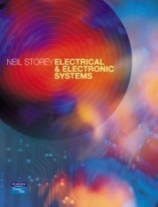
Semiconductor Diodes
Chapter 19
    Introduction
    Diodes
    Electrical Properties of Solids
    Semiconductors
    pn Junctions
    Semiconductor Diodes
    Special-Purpose Diodes
    Diode Circuits

Slide 2
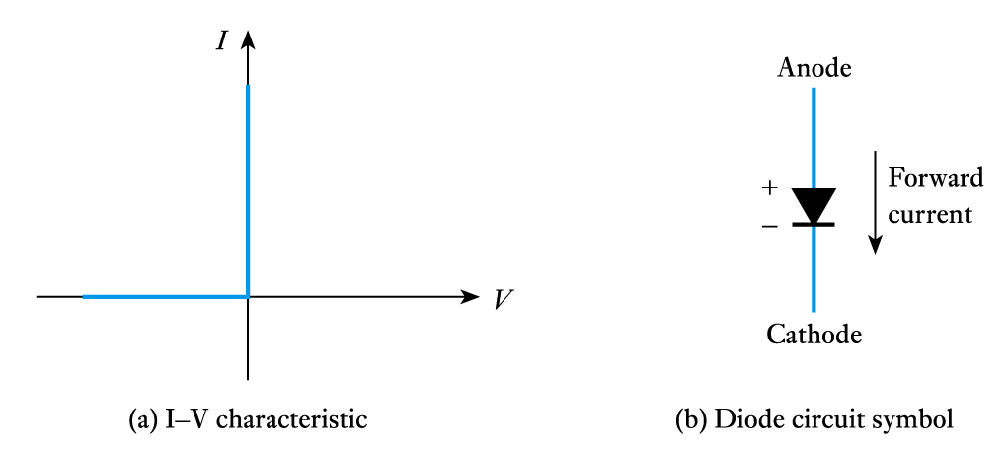
Diodes
19.2
An ideal diode passing electricity in one direction but not the other

Slide 3
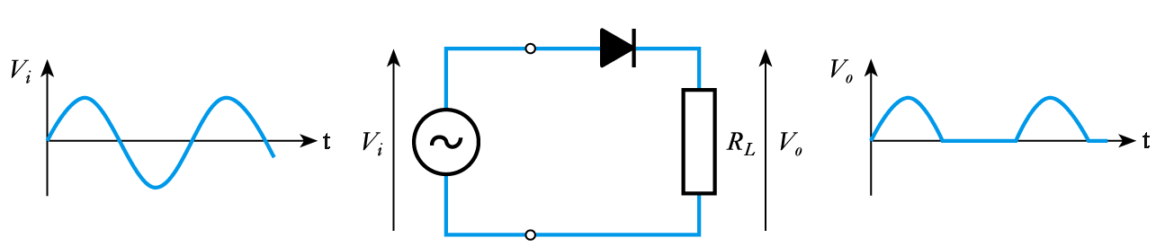
Rectifiers
One application of diodes is in rectification
  the example below shows a half-wave rectifier
In practice, no real diode has ideal characteristics but semiconductor pn junctions make good diodes
To understand such devices we need to look at some properties of materials

Slide 4
Electrical Properties of Solids
19.3
Conductors
  e.g. copper or aluminium
  have a cloud of free electrons (at all temperatures above absolute zero). If an electric field is applied electrons will flow causing an electric current
Insulators
  e.g. polythene
  electrons are tightly bound to atoms so few can break free to conduct electricity

Slide 5
Semiconductors
  e.g. silicon or germanium
  at very low temperatures these have the properties of insulators
  as the material warms up some electrons break free and can move about, and it takes on the properties of a conductor - albeit a poor one
  however, semiconductors have several properties that make them distinct from conductors and insulators

Slide 6
Semiconductors
19.4
Pure semiconductors
  thermal vibration results in some bonds being broken generating free electrons which move about
  these leave behind holes which accept electrons from adjacent atoms and therefore also move about
  electrons are negative charge carriers
  holes are positive charge carriers
At room temperatures there are few charge carriers
  pure semiconductors are poor conductors
  this is intrinsic conduction

Slide 7
Doping
  the addition of small amounts of impurities drastically affects its properties
  some materials form an excess of electrons and produce an n-type semiconductor
  some materials form an excess of holes and produce a p-type semiconductor
  both n-type and p-type materials have much greater conductivity than pure semiconductors
  this is extrinsic conduction

Slide 8
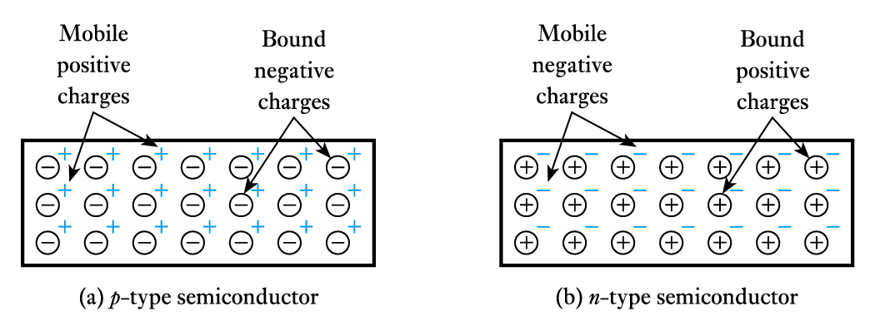
The dominant charge carriers in a doped semiconductor (e.g. electrons in n-type material) are called majority charge carriers. Other type are minority charge carriers
The overall doped material is electrically neutral

Slide 9
pn Junctions
19.5
When p-type and n-type materials are joined this forms a pn junction
  majority charge carriers on each side diffuse across the junction where they combine with (and remove) charge carriers of the opposite polarity
  hence around the junction there are few free charge carriers and we have a depletion layer (also called a space-charge layer)

Slide 10
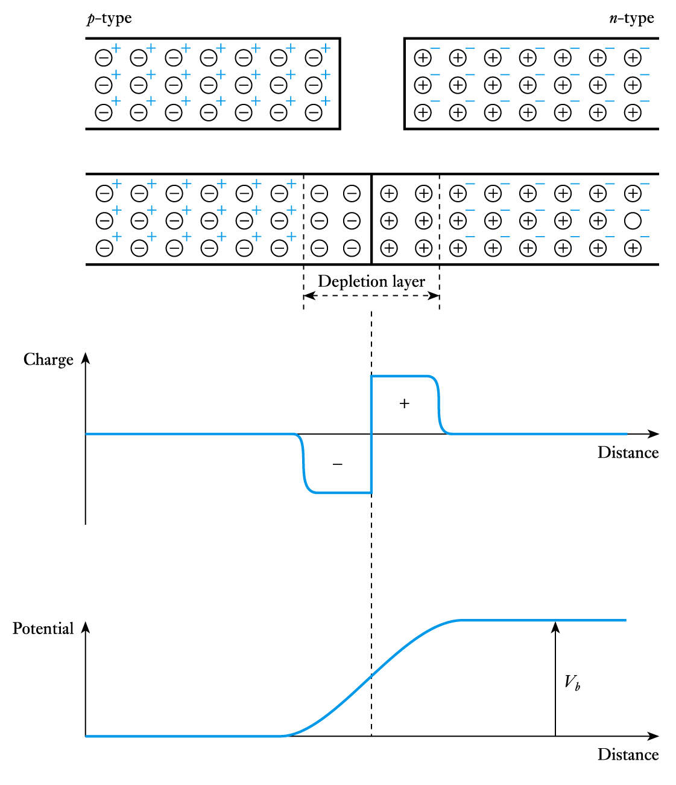
The diffusion of positive charge in one direction and negative charge in the other produces a charge imbalance
  this results in a potential barrier across the junction

Slide 11
Potential barrier
  the barrier opposes the flow of majority charge carriers and only a small number have enough energy to surmount it
    this generates a small diffusion current
  the barrier encourages the flow of minority carriers and any that come close to it will be swept over
    this generates a small drift current
  for an isolated junction these two currents must balance each other and the net current is zero

Slide 12
Forward bias
  if the p-type side is made positive with respect to the
  n-type side the height of the barrier is reduced
  more majority charge carriers have sufficient energy to surmount it
  the diffusion current therefore increases while the drift current remains the same
  there is thus a net current flow across the junction which increases with the applied voltage

Slide 13
Reverse bias
  if the p-type side is made negative with respect to the
  n-type side the height of the barrier is increased
  the number of majority charge carriers that have sufficient energy to surmount it rapidly decreases
  the diffusion current therefore vanishes while the drift current remains the same
  thus the only current is a small leakage current caused by the (approximately constant) drift current
  the leakage current is usually negligible (a few nA)

Slide 14
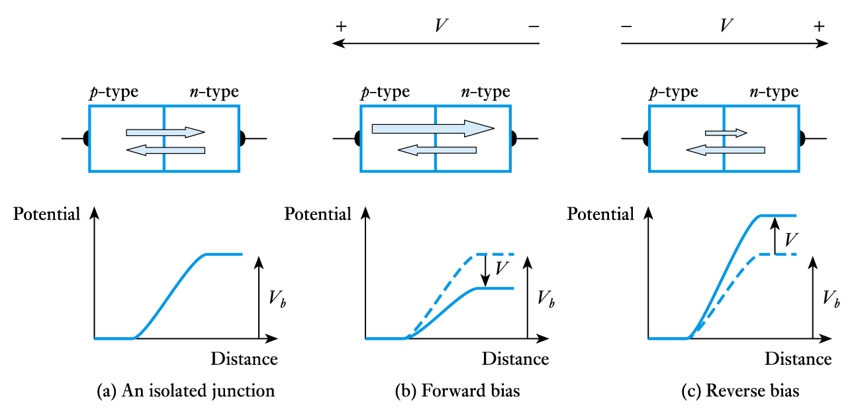
Currents in a pn junction

Slide 15
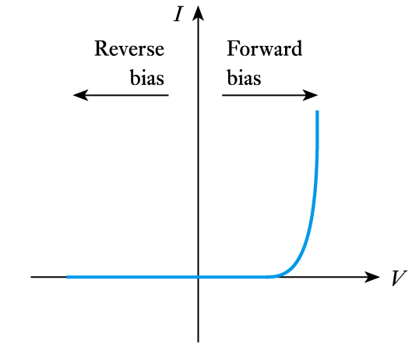
Semiconductor Diodes
19.6
Forward and reverse currents

Slide 16
Silicon diodes
  generally have a turn-on voltage of about 0.5 V
  generally have a conduction voltage of about 0.7 V
  have a breakdown voltage that depends on their construction
    perhaps 75 V for a small-signal diode
    perhaps 400 V for a power device
  have a maximum current that depends on their construction
    perhaps 100 mA for a small-signal diode
    perhaps many amps for a power device

Slide 17
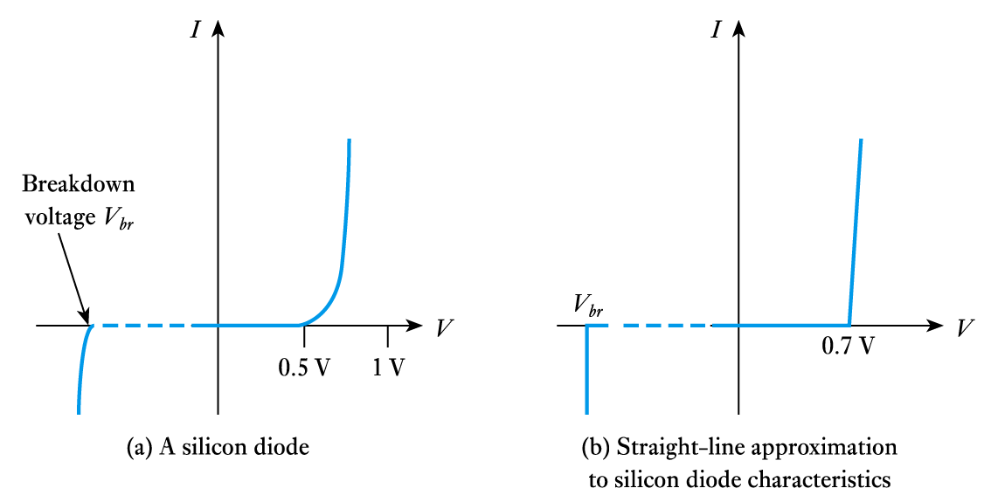
Turn-on and breakdown voltages for a silicon device

Slide 18
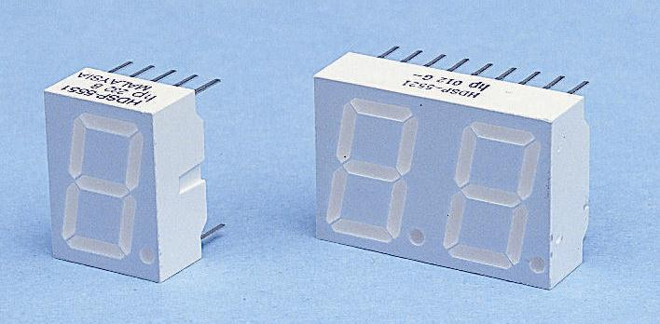
Special-Purpose Diodes
19.7
Light-emitting diodes
  discussed earlier when we looked at light actuators

Slide 19
Key Points
Diodes allow current to flow in only one direction
At low temperatures semiconductors act like insulators
At higher temperatures they begin to conduct
Doping of semiconductors leads to the production of p-type and n-type materials
A junction between p-type and n-type semiconductors has the properties of a diode
Silicon semiconductor diodes approximate the behaviour of ideal diodes but have a conduction voltage of about 0.7 V
There are also a wide range of special purpose diodes
Diodes are used in a range of applications

